Slide 1
Adv. Biopharmaceutics
Dr. Mohammed Sabbar
College Of Pharmacy - Basrah
3rd Oct. 2018
http://bit.do/ex2aD

Slide 2
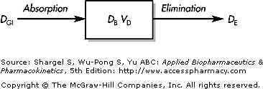
PHARMACOKINETICS OF DRUG ABSORPTION
The rate of disappearance of drug from the gastrointestinal tract
=
where k _{a} is the first-order absorption rate constant from the GI tract, F is the fraction absorbed, and D _{GI} is the amount of drug in solution in the GI tract at any time t

Slide 3
PHARMACOKINETICS OF DRUG ABSORPTION
The rate of drug change in the body
=
where k _{a} is the first-order absorption rate constant from the GI tract, F is the fraction absorbed, and D _{GI} is the amount of drug in solution in the GI tract at any time t

Slide 4
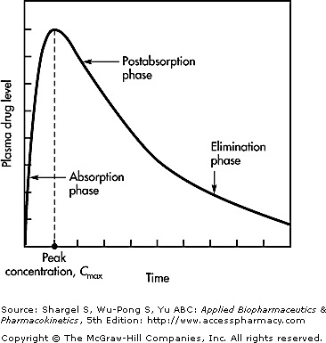

Slide 5
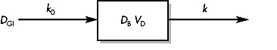
ZERO-ORDER ABSORPTION MODEL
One-compartment pharmacokinetic model for
Zero-order drug absorption and first-order elimination.

Slide 6
FIRST-ORDER ABSORPTION MODEL
One-compartment pharmacokinetic model for
first-order drug absorption and first-order elimination.
The rate of disappearance of drug from the gastrointestinal tract
=
On Integration
where D ₀ is the dose of the drug.

Slide 7
The rate of drug change in the body

Slide 8
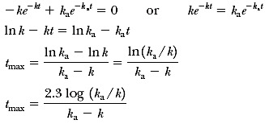
Cmax and tmax
Cmax=?????

Slide 9
Determination of Absorption Rate Constants from Oral Absorption Data
METHOD OF RESIDUALS

Slide 10
Thank you

